Slide 1
SAP S/4 HANA Training
Mahesh Koleti and Sai Gopal KVP
Notes:
The below and following notes on the template slides are to guide you only. In your final presentation, you may delete these notes and add relevant notes if any.
Title slide:
Title – should not exceed beyond 3 lines, font size 30-34, Arial Bold
(Font size for the title of the PPT can vary between 30-34, Arial, Bold depending on the amount of text, however should not be smaller than 30 font size)
Name should not exceed beyond 1 line, Designation; font size to remain at 16, Arial normal
Please keep the title slide simple, just the logo, title and name and designation to appear. No other graphic elements or any design, photograph, image can be added to this slide, alignment to remain the same

Slide 2
Agenda

Slide 3
Introduction of S4 HANA
Financial Accounting
Management Accounting
Migration
Central Finance

Slide 4
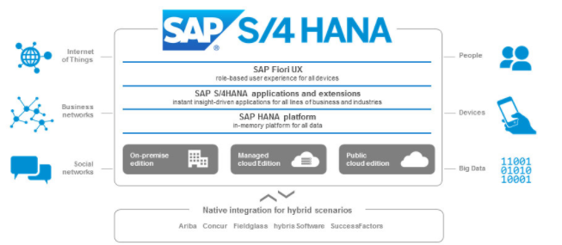
Business Case
Digital Economy: Growth of digital devices and services has grown exponentially over the past few years such as use of smart phone, tablets , online shopping, ticket reservations, bank transaction etc.
Internet of Things: By 2020, 5 billion people will enter the middle class and come online, while 50 billion devices will be connected to the Internet of Things, creating a digital network of virtually everything. And cloud computing - a $41 billion business in 2011 - will grow to a $241 billion business in that same time frame.
Choice of Deployment: Cloud Computing: On premise can be deployed on either at customer site or on cloud via Hana Enterprise cloud. Whereas SAP Hana cloud finance that runs with version number 1705, 1708 etc runs exclusively on cloud and its different in terms of system properties and setup.
@2017 WIPRO LIMITED - INTERNAL

Slide 5
Problems- Existing Systems
Tradeoff: With the existing system architecture, you have to make a trade-off; either going for a Broad and Deep Analysis or Speedy and Simple reporting.
No Real Time Data: Online transactional processing (OLTP) was separated from online analytic processing (OLAP). The reason for this lies in the database design of OLTP and OLAP. Quite simply, a database model was either built for OLTP optimization or OLAP optimization, but not both. However, this also bought with it complexity, redundancy and of course latency. It was usual for today’s business figures to be only available tomorrow for analysis once the data was extracted and loaded to a reporting system.In both scenarios, real time updates are difficult, almost impossible to design. In a data warehouse environment updates occur overnight with nightly batch jobs.
Hierarchical Model: Traditional applications were built on a hierarchical data model. Detailed data was summarized into higher level layers of aggregates to help system performance. On top of aggregates we built more aggregates and special versions of the database tables to support special applications. So as well as storing the extra copies of data, we also had to build application code to maintain extra tables and keep them up to date.
Indexes: Database indexes improve access speed because they are based on common access paths to data. But they must be constantly dropped and rebuilt each time the tables are updated, more code is required to manage this process.
More Codes: The traditional data model is complex and a complex data model causes the application code to be complex. It has been found that up to 70% of application code is built specifically for performance of an application and adds no value to the core business function. With a complex data model and complex code, integration with other applications and also enhancements are difficult, and simply not agile.
Row based database takes time to process the single data. Therefore, speed and availability is the main issue faced by business.
@2017 WIPRO LIMITED - INTERNAL

Slide 6
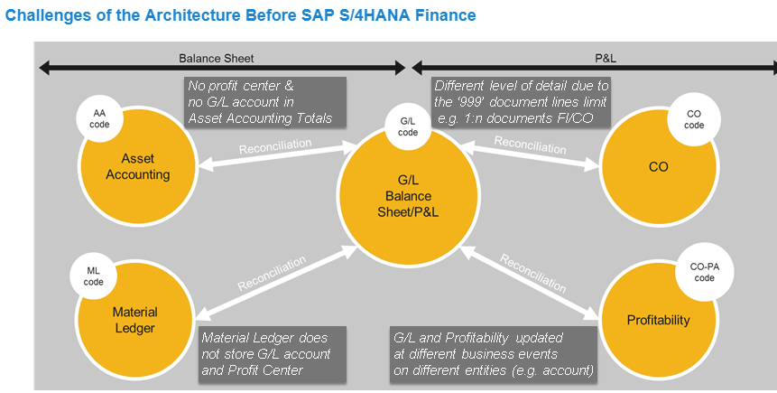
Problems- Existing Data Models
Challenges from having Multiple Sources of Truth include the following:
The combined content of several tables represents "the truth". Reconciliation efforts are needed by architecture.
Different level of detail stored in the respective components or tables.
Components are structured differently (for example, fields and entities differ).
Must move data to the appropriate table for reporting (for example, settlement).
Different capabilities in the components (customer fields, currencies, multi-GAAP, and so on).
Multiple BI extractors required to cover the complete truth in BI
@2017 WIPRO LIMITED - INTERNAL

Slide 7
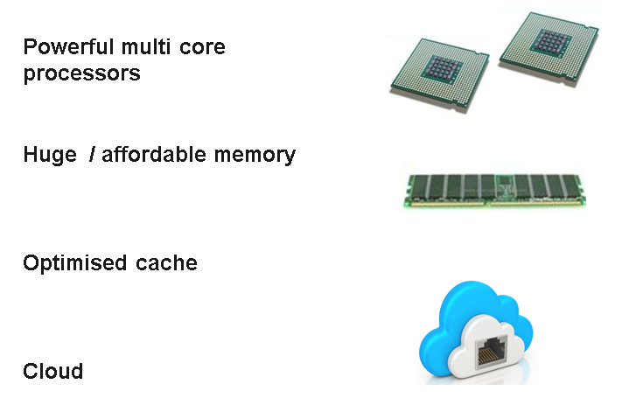
Hardware Enhancements
Multi-core processors enable parallelism of tasks - this means more throughput of data and faster processing to give us real-time responses.
Large memory - enables us to fit an entire organization's database in memory - this means that we lose the mechanical spinning disk and the latency it brings.
On Board Cache- Advances in the design of on-board cache means that data can pass between memory and CPU cores rapidly. In the past, even with large memory, this was a bottleneck as CPUs were demanding more data and the journey from memory to CPU was not optimal.
Cloud computing- Cloud computing technology has matured in the last few years and is now a compelling deployment option for our customers who do not want to take on the complexity and cost of the installation and maintenance of IT landscapes. Virtualizing machines means lower costs of running enterprise wide applications. Public cloud services based on subscription models increase access to everyone to the latest solutions, reducing the costs and simplifying everything.
In memory technology- SAP HANA is an in-memory, column-oriented, relational database management system
Apps – Applications that are easily accessible via computer, Mobile or tablet to perform regular transactions such as Banking, email etc
@2017 WIPRO LIMITED - INTERNAL

Slide 8
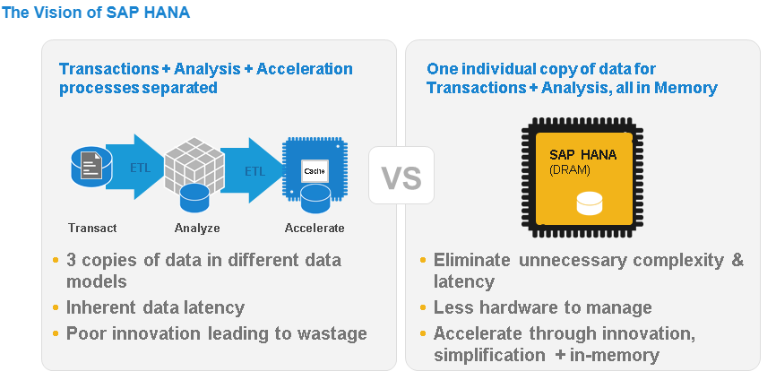
Advantages of Hana Database
Database-The database, which supports S/4HANA (SAP HANA) can handle both OLTP and OLAP processing from a single data model and therefore we do not need to move transactional data to a separate system. This means transactional and analytical applications run off the same tables and therefore data is available in real-time at every level of detail.
Analytics-Gain new insights from advanced analytics processing by leveraging in-memory data processing capabilities – text, predictive, spatial, graph, streaming, and time series – you can get answers to any business question and make smart decisions in real time
Application- Develop next-generation applications that combine analytics and transactions, and deploy them on any device. Take advantage of best-in-class development tools – and deliver personalised experiences with the right data served at the right time for users.
Data Access- Gain a complete and accurate view of your business by accessing data from any source – internal or external. Access data where it’s located, integrate or replicate relevant data into SAP HANA, and ensure data quality to increase confidence in decision making.
Administration- Simplify system administration and IT operations with tools that help you monitor processes, ensure data and application security, and achieve continuous availability. Keep your business running smoothly and effectively – from any device or location
Security-Keep your communications, data storage, and application services secure with robust identity and access management controls. Rely on best-in-class software security, patching, and encryption – and use a dashboard to monitor all KPIs related to security.
@2017 WIPRO LIMITED - INTERNAL

Slide 9
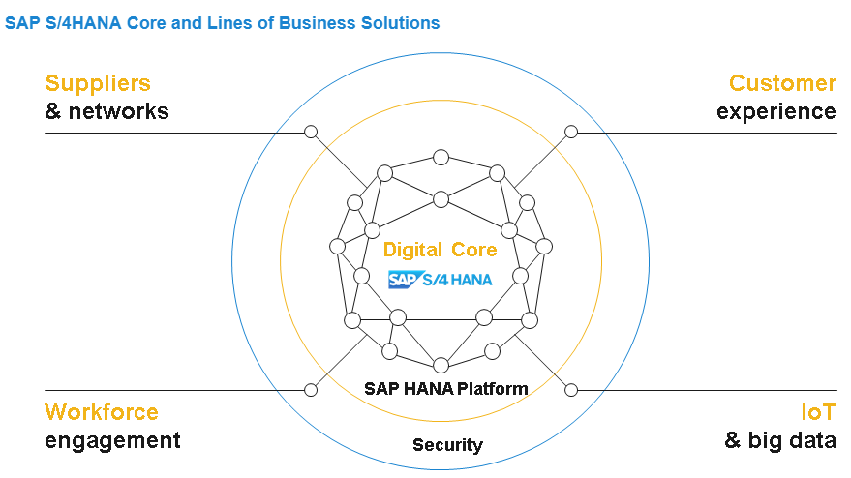
S/4 Hana Suite
Simplified Core- SAP S/4HANA is not a single product but covers many applications. Customers can start with the basics components and add to them later. S/4HANA Enterprise Management is a great place to start. This is known as the simplified core and can be considered as the replacement for SAP ERP.
S/4HANA Enterprise Management can be easily integrated with SAP S/4HANA Lines of Business (LoB) solutions..
In the past, we had multiple add-on applications surrounding the core with overlapping models and much redundancy (for example, SAP CRM and SAP SRM surrounded the core ECC). Now overlaps and redundancy have been completely removed from SAP S/4HANA.
SAP S/4HANA is built natively and optimally to run only on the SAP HANA platform.
Examples- Successfactors- HR, Fieldglass for contingent workers, Ariba for p2p, Hybris for sales and Concur for travel mgt
@2017 WIPRO LIMITED - INTERNAL

Slide 10
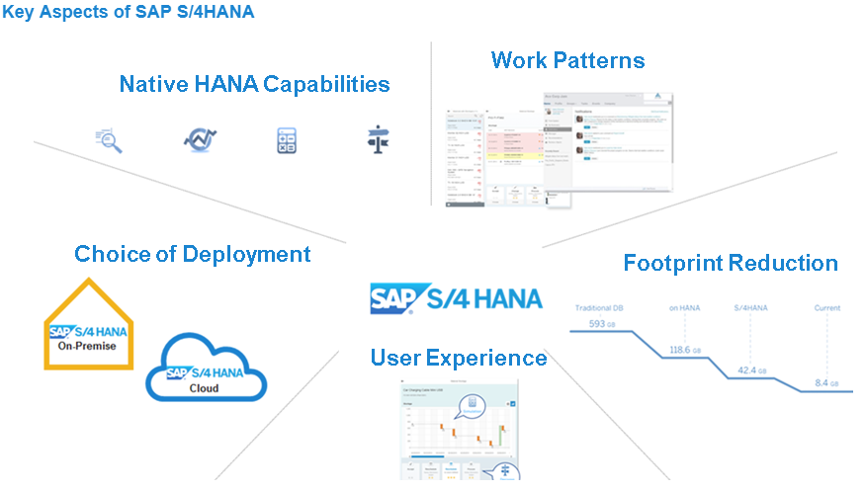
Advantages of S/4 Hana Suite
Native Hana capabilities- SAP S/4HANA is built on SAP HANA, and so inherits all the capabilities of this powerful in-memory data management and application platform. This includes advanced text mining, predictive analysis, simulations, and powerful real time decision support, with access to any type of data in real time.
User experience & Work Patterns- A brand new user experience is delivered to improve the productivity and satisfaction of business users and brings the interface up to a consumer-grade experience optimized for any device.
Deployment choice- SAP S/4HANA can be deployed on-premise or in the cloud or a combination of both to provide flexible consumption options to customers.
Foot print reduction-The data model has been simplified. This means unnecessary tables have been removed, and of course the data in those tables, in order to shrink the footprint dramatically and simplify the application design and extensibility.
Higher throughput and Full flexibility- It offers a higher throughput, 3 to 7 times faster at processing of your data. It is fully flexible without pre-configured indices, without pre-configured summarizations, and you can use your data in new ways that until now were impossible. It is enterprise software designed with big data and agility at its core.
@2017 WIPRO LIMITED - INTERNAL

Slide 11
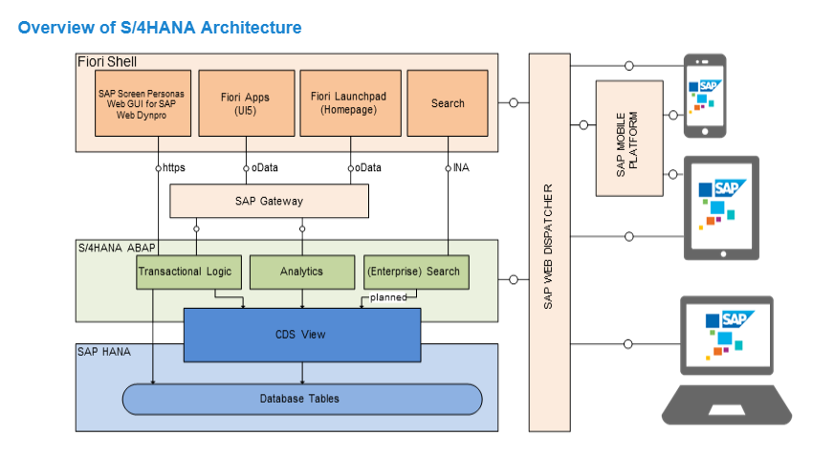
SAP S/4 Hana Architecture Rational
Reconciliation- Easy reconciliation because of single source of truth and elimination of many tables
Speed and Insight- Hana advantages as mentioned previous slides creates a simple but holistic data model.
Universal Journal- The universal journal combines and harmonizes the good qualities of all accounting components.
Safe guarding customer investments - Non-disruptive innovation and simplification. SAP aims at improvement with least possible disruption to existing business. One of the basic promises and focus of SAP S/4HANA development is to provide a product that does not disrupt the business processes and the day-to-day life of a business. A great effort has been made to safeguard the customer investments that were made in custom code.
Existing programs and interfaces can still be used through generated compatibility views:
Read access from custom ABAP programs or reports to prior tables work as before.
Read access is automatically redirected to the universal journal as the new single source of truth.
All programs with write access to those deleted tables replaced by CDS views will cause problems and cannot be used anymore without adaptation. To do this, remove all write accesses for the tables that have been replaced by views. You can use the code inspector to find all affected sections of the code (see SAP note 1976487).
@2017 WIPRO LIMITED - INTERNAL

Slide 12
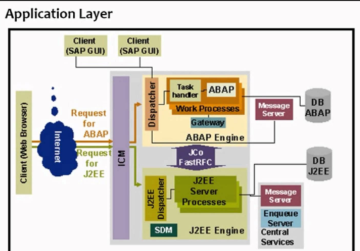
Comparison with ECC VS S4 hana
SAP ECC
SAP S4 Hana
@2017 WIPRO LIMITED - INTERNAL

Slide 13
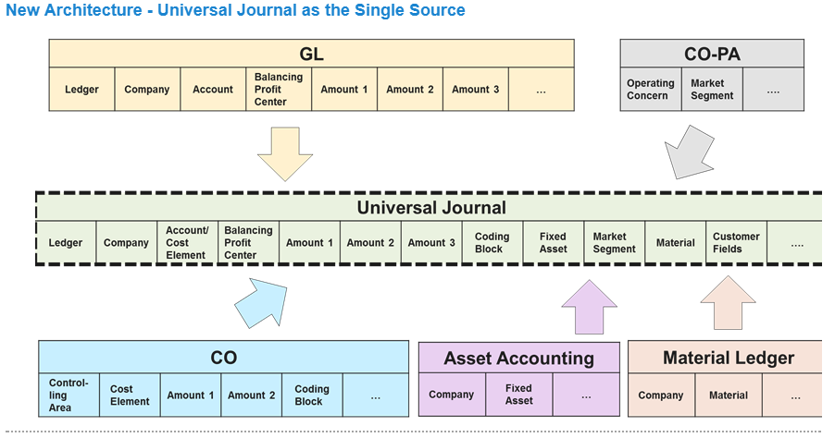
Architecture in detail
The Universal Journal is now the single source of truth. Each posting creates line items in the universal journal table that combines all data entered in the different financial components into one single structure.
Benefits of the new architecture include:
One line item table with full detail for all components. Data stored only once, so no reconciliation needed by architecture.
Fast multi-dimensional reporting on the Universal Journal possible without replicating data to BI. If BI is in place, one single BI extractor is needed.
Reduction of memory footprint through elimination of redundancy.
Technical preparation done to enhance important structural capabilities of the Financials solution (for example, multi-GAAP, additional currencies).
@2017 WIPRO LIMITED - INTERNAL

Slide 14
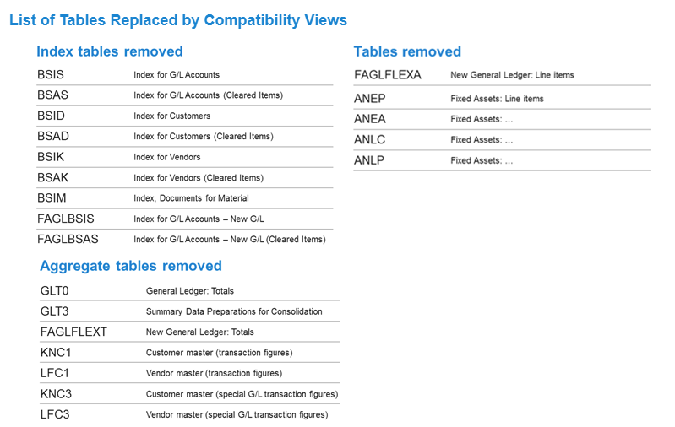
Changes to tables- Safeguarding customer investments
@2017 WIPRO LIMITED - INTERNAL

Slide 15
Release Versions
On Premise and Hana Enterprise Cloud Editions:
1503- Simple finance add-on only for finance solutions
1605- Add on for finance area
1511- Introduction of simple logistics and integration with finance applications
1610- Enhanced version with simple logistics
1709 – Last version released by sap with document splitting functionalities. After this on premise editions will not be released by SAP. However, sp upgrades will be released
Cloud Editions- Public Cloud- SAP will upgrade for every three months. Currently, 1711 is in progress.
Implementation types
New implementation
System conversion
Landscape Transformation
@2017 WIPRO LIMITED - INTERNAL

Slide 16
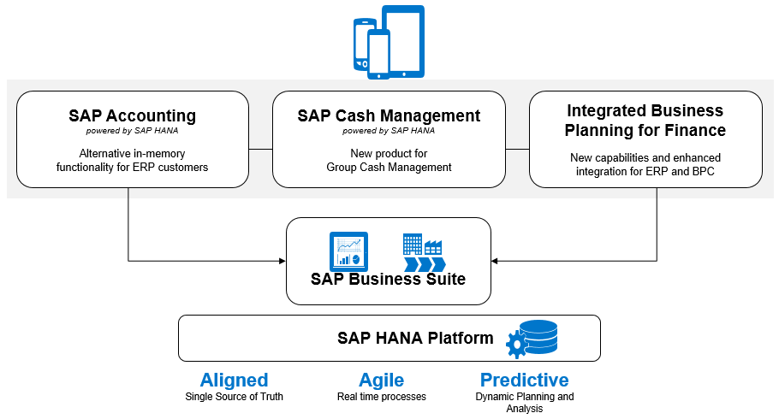
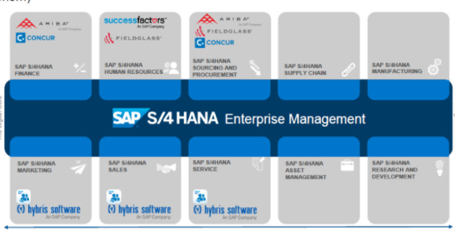
Components
The following are the components that make simplified core
Sap business suite license consists of following
Hana Database
Fiori Apps
SAP Business Suite
Embedded BW
Separate License are required for following
Cash management
IBP or BPC
Ariba
Fieldglass
Successfactors
Concur
Hybris
@2017 WIPRO LIMITED - INTERNAL

Slide 17
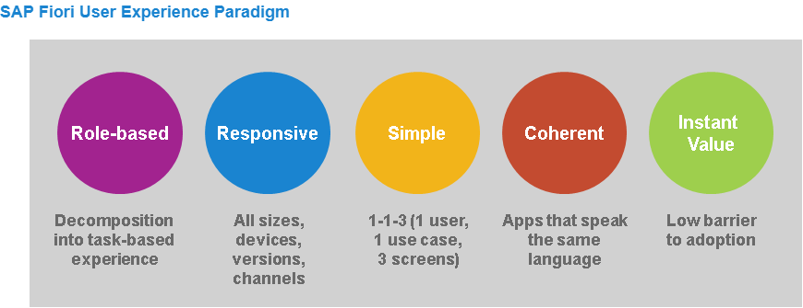
Fiori Apps
FIORI Apps allow user to access SAP from any device and provides increased user experience
Fiori apps are :
Role based
Responsive
Simple
Coherent
Instant Value
Each user when working on fiori is assigned to catalogs for each area. The area can be Accounts payable, Accounts receivable etc, Please see below link
https://fioriappslibrary.hana.ondemand.com/sap/fix/externalViewer/
@2017 WIPRO LIMITED - INTERNAL

Slide 18
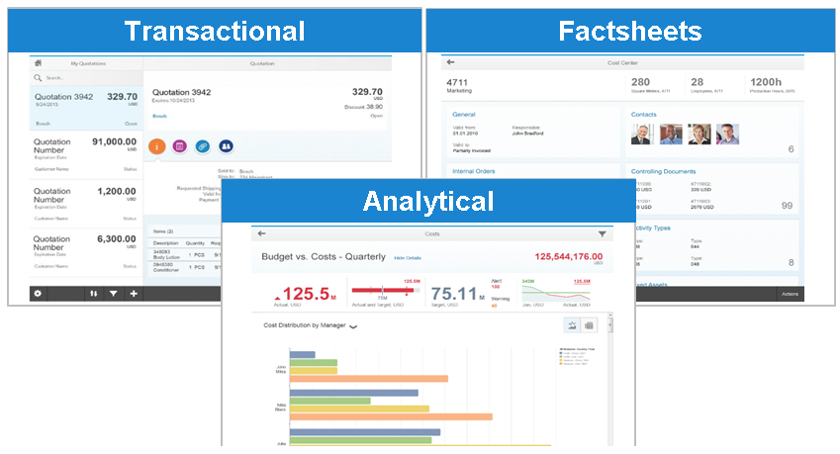
Type of Fiori Apps
Transaction apps offer task-based access to tasks like change, create, display (documents, master records), or entire processes with guided navigation.
Analytical apps provide insight to action, they give you a visual overview of complex topics for monitoring or tracking purposes.
Factsheets give you the opportunity to search and explore your data. They provide a 360 degree view on essential information about an object and contextual navigation between related objects.
@2017 WIPRO LIMITED - INTERNAL

Slide 19
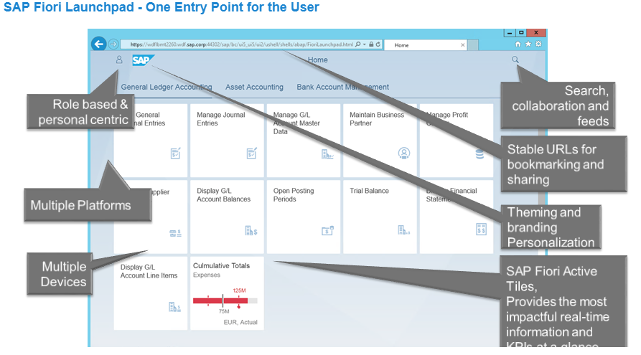
Fiori- Detail
The SAP Fiori launchpad is the single entry point for the user to interact with the system. It is role-based and persona centric. The users access those applications that are specific to their role within the company and allow them to perform the specific tasks as per their requirement. There is embedded search, collaboration, and feed functionality.
The SAP Fiori launchpad offers themes and can be personalized to meet branding requirements.
It offers a stable URL for bookmarking and sharing and as it is browser based, it works with multiple devices and browsers.
The launchpad also offers active tiles through which the user can receive updated information directly from the front page without opening the application.
@2017 WIPRO LIMITED - INTERNAL

Slide 20
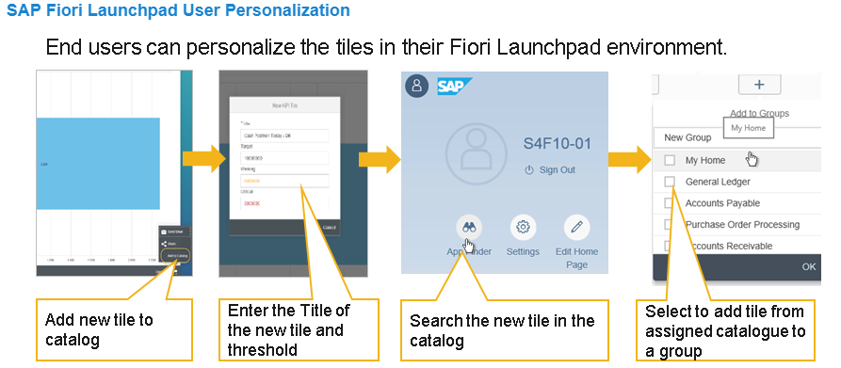
Fiori- Launchpad
The following personalization options are available in SAP Fiori launchpad:
Adding applications from the catalog assigned to them
Removing applications that they do not want to use
Modifying and adding applications for filtered report results
For example, if the user is a group cash manager who is interested in the German market, the user can create an application to take them directly to the cash position of the German market. They can arrive at the cash position directly with one click from the SAP Fiori launchpad home page.
@2017 WIPRO LIMITED - INTERNAL

Slide 21
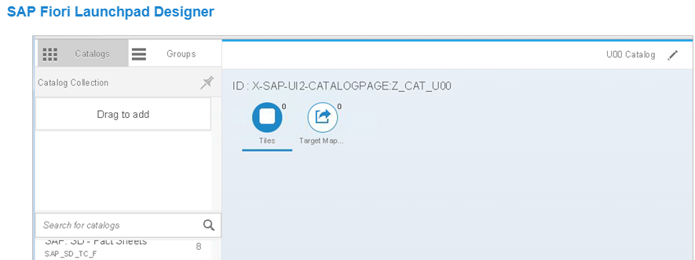
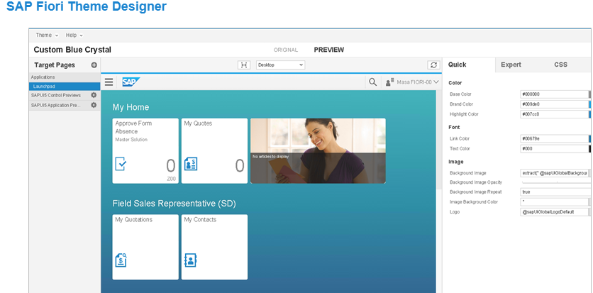
Additional features☺
Personalization Aspect
@2017 WIPRO LIMITED - INTERNAL

Slide 22
Further learning & Help
Help.sap.com/viewer
Fiori Apps Library -> https://fioriappslibrary.hana.ondemand.com/sap/fix/externalViewer/#/homePage
Fiori Apps Finance -> https://fioriappslibrary.hana.ondemand.com/sap/fix/externalViewer/#/home
@2017 WIPRO LIMITED - INTERNAL

